Slide 1
VENKATRAMA PHANI KUMAR S Asst. Professor, Department of CSE VFSTR University
UNIT-5
File-System Interface

Slide 2

Topics to be Covered
File Concept
Access Methods
Disk and Directory Structure
File-System Mounting
File Sharing
Protection

Slide 3
Objectives
To explain the function of file systems
To describe the interfaces to file systems
To discuss file-system design tradeoffs, including access methods, file sharing, file locking, and directory structures
To explore file-system protection

Slide 4
File Concept
Contiguous logical address space
Types:
Data
numeric
character
binary
Program
Contents defined by file’s creator
Many types
Consider text file, source file, executable file

Slide 5
File Attributes
Name – only information kept in human-readable form
Identifier – unique tag (number) identifies file within file system
Type – needed for systems that support different types
Location – pointer to file location on device
Size – current file size
Protection – controls who can do reading, writing, executing
Time, date, and user identification – data for protection, security, and usage monitoring
Information about files are kept in the directory structure, which is maintained on the disk
Many variations, including extended file attributes such as file checksum
Information kept in the directory structure

Slide 6
File Operations
File is an abstract data type
Create
Write – at write pointer location
Read – at read pointer location
Reposition within file - seek
Delete
Truncate
Open(F_{i}) – search the directory structure on disk for entry F_{i}, and move the content of entry to memory
Close (F_{i}) – move the content of entry F_{i} in memory to directory structure on disk

Slide 7
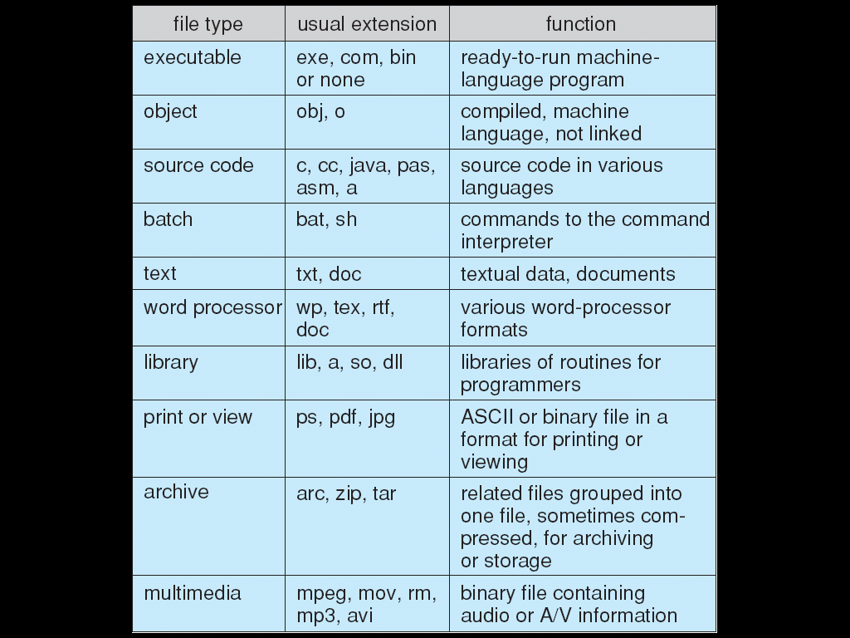
File Types – Name, Extension

Slide 8
File Structure
Simple record structure
Lines
Fixed length
Variable length
Complex Structures
Formatted document
Relocatable load file
Can simulate last two with first method by inserting appropriate control characters
Who decides:
Operating system
Program

Slide 9
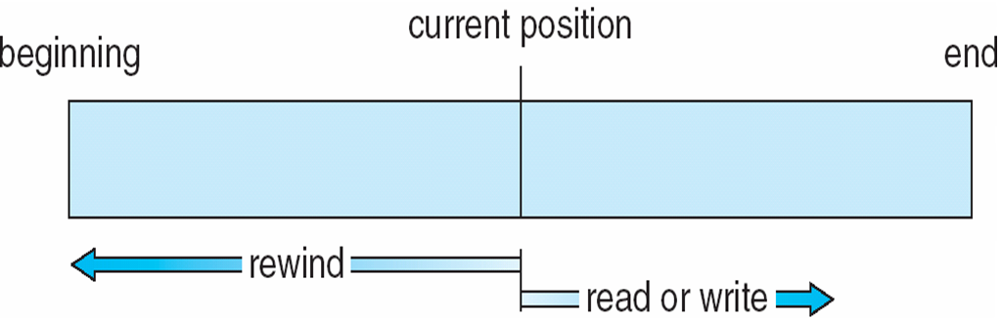
Sequential-access File

Slide 10
Access Methods
Sequential Access
read next
write next
reset
no read after last write
(rewrite)
Direct Access – file is fixed length logical records
read n
write n
position to n
read next
write next
rewrite n
n = relative block number
Relative block numbers allow OS to decide where file should be placed

Slide 11
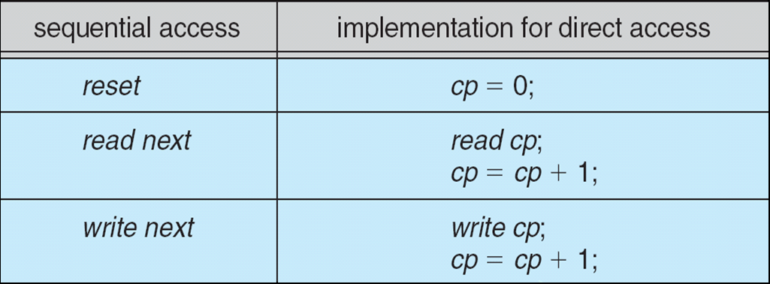
Simulation of Sequential Access on Direct-access File
Storage-Device Hierarchy

Slide 12
Other Access Methods
Can be built on top of base methods
General involve creation of an index for the file
Keep index in memory for fast determination of location of data to be operated on (consider UPC code plus record of data about that item)
If too large, index (in memory) of the index (on disk)
IBM indexed sequential-access method (ISAM)
Small master index, points to disk blocks of secondary index
File kept sorted on a defined key
All done by the OS
VMS operating system provides index and relative files as another example (see next slide)

Slide 13
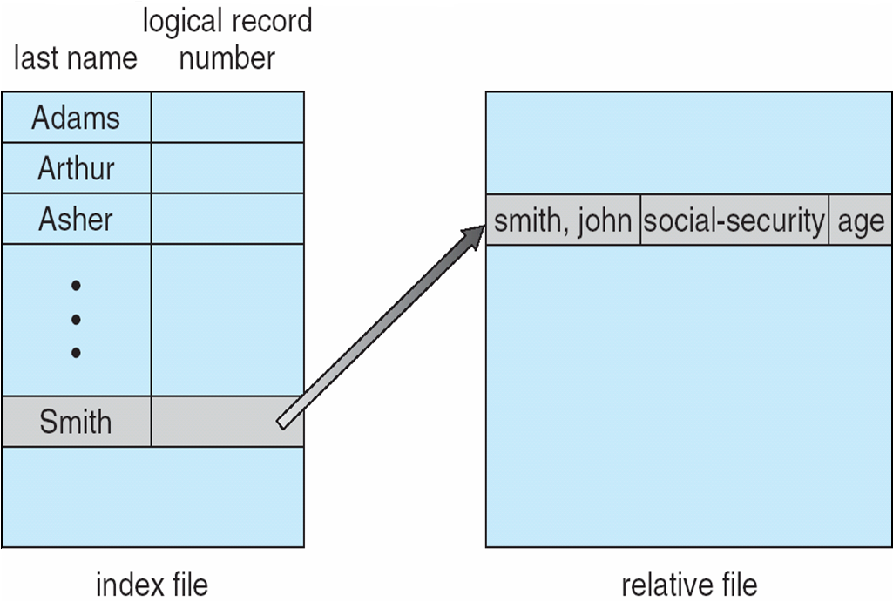
Ex: of Index and Relative Files

Slide 14
Directory Structure
A collection of nodes containing information about all files
Directory
Files
Both the directory structure and the files reside on disk
F 1
F 2
F 3
F 4
F n

Slide 15
Operations Performed on Directory
Search for a file
Create a file
Delete a file
List a directory
Rename a file
Traverse the file system

Slide 16
Directory Organization
The directory is organized logically to obtain:
Efficiency – locating a file quickly
Naming – convenient to users
Two users can have same name for different files
The same file can have several different names
Grouping – logical grouping of files by properties, (e.g., all Java programs, all games, …)

Slide 17
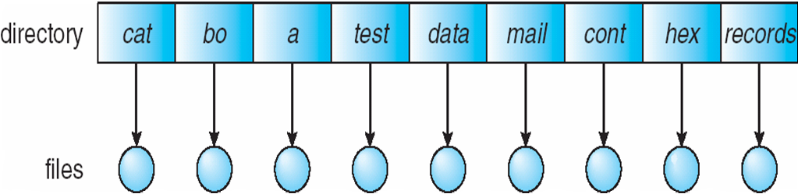
Single-Level Directory
A single directory for all users
Naming problem
Grouping problem

Slide 18
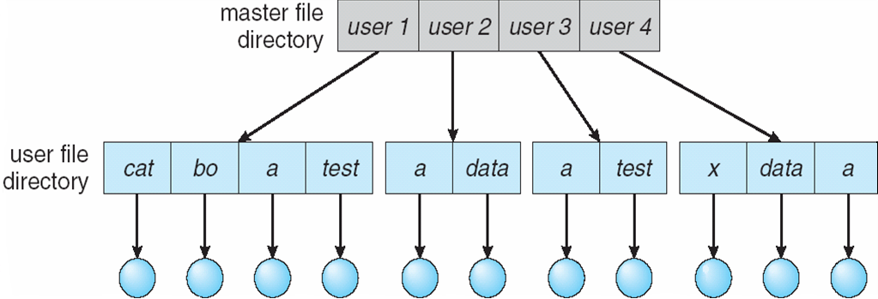
Two-Level Directory
separate directory for each user
Path name
Can have the same file name for different user
Efficient searching
No grouping capability

Slide 19
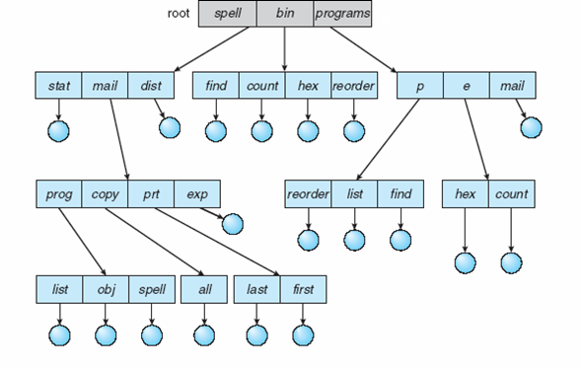
Tree-Structured Directories

Slide 20
Tree-Structured Directories (Cont.)
Efficient searching
Grouping Capability
Current directory (working directory)
cd /spell/mail/prog
type list

Slide 21
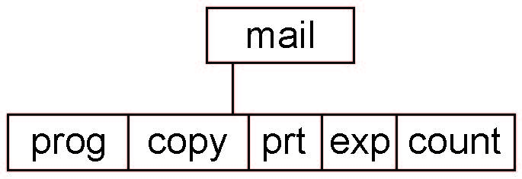
Tree-Structured Directories (Contd.)
Absolute or relative path name
Creating a new file is done in current directory
Delete a file
rm <file-name>
Creating a new subdirectory is done in current directory
mkdir <dir-name>
Example: if in current directory /mail
mkdir count
Deleting “mail” ⇒ deleting the entire subtree rooted by “mail”

Slide 22
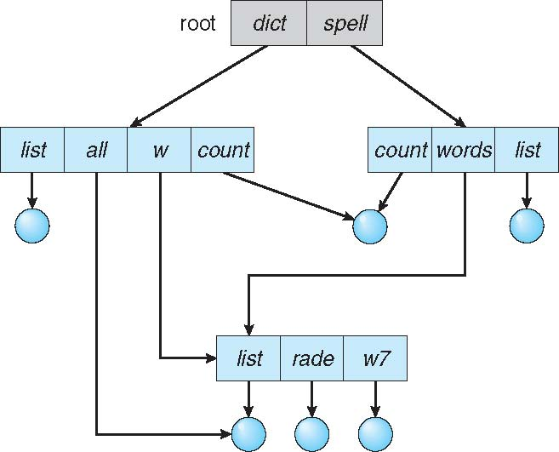
Acyclic-Graph Directories
Have shared subdirectories and files

Slide 23
Acyclic-Graph Directories (Contd.)
Two different names (aliasing)
If dict deletes list ⇒ dangling pointer
Solutions:
Backpointers, so we can delete all pointers Variable size records a problem
Backpointers using a daisy chain organization
Entry-hold-count solution
New directory entry type
Link – another name (pointer) to an existing file
Resolve the link – follow pointer to locate the file

Slide 24
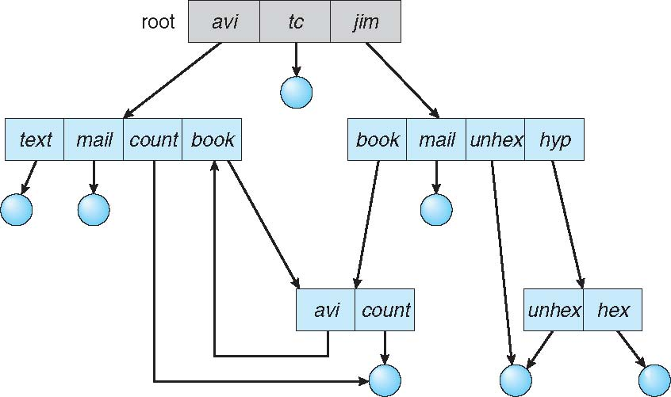
General Graph Directory

Slide 25
General Graph Directory (Cont.)
How do we guarantee no cycles?
Allow only links to file not subdirectories
Garbage collection
Every time a new link is added use a cycle detection algorithm to determine whether it is OK

Slide 26
File System Mounting
A file system must be mounted before it can be accessed
A unmounted file system (i.e., Fig. 11-11(b)) is mounted at a mount point

Slide 27
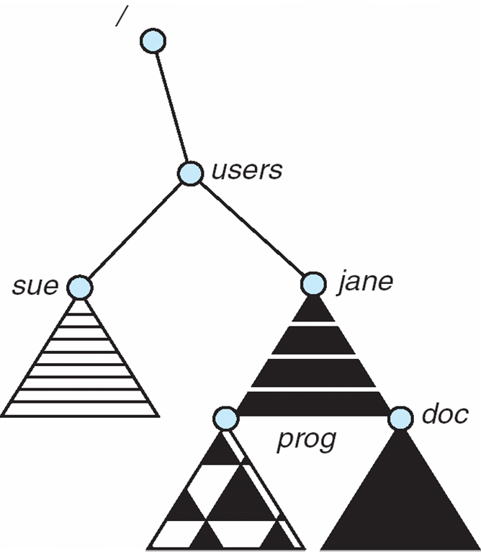
Mount Point

Slide 28
File Sharing
Sharing of files on multi-user systems is desirable
Sharing may be done through a protection scheme
On distributed systems, files may be shared across a network
Network File System (NFS) is a common distributed file-sharing method
If multi-user system
User IDs identify users, allowing permissions and protections to be per-user Group IDs allow users to be in groups, permitting group access rights
Owner of a file / directory
Group of a file / directory

Slide 29
File Sharing – Remote File Systems
Uses networking to allow file system access between systems
Manually via programs like FTP
Automatically, seamlessly using distributed file systems
Semi automatically via the world wide web

Slide 30
File Sharing – Remote File Systems
Client-server model allows clients to mount remote file systems
Server can serve multiple clients
Client and user-on-client identification is insecure or complicated
NFS is standard UNIX client-server file sharing protocol
CIFS is standard Windows protocol
Standard operating system file calls are translated into remote calls
Distributed Information Systems (distributed naming services) such as LDAP, DNS, NIS, Active Directory implement unified access to information needed for remote computing

Slide 31
File Sharing – Failure Modes
All file systems have failure modes
For example corruption of directory structures or other non-user data, called metadata
Remote file systems add new failure modes, due to network failure, server failure
Recovery from failure can involve state information about status of each remote request
Stateless protocols such as NFS v3 include all information in each request, allowing easy recovery but less security

Slide 32
Protection
File owner/creator should be able to control:
what can be done
by whom
Types of access
Read
Write
Execute
Append
Delete
List

Slide 33
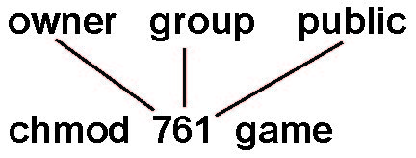
Access Lists and Groups
Mode of access: read, write, execute
Three classes of users on Unix / Linux
RWX
a) owner access 7 ⇒ 1 1 1 RWX
b) group access 6 ⇒ 1 1 0
RWX
c) public access 1 ⇒ 0 0 1
Ask manager to create a group (unique name), say G, and add some users to the group.
For a particular file (say game) or subdirectory, define an appropriate access.
Attach a group to a file chgrp G game

Slide 34
End

Slide 35
VENKATRAMA PHANI KUMAR S Asst. Professor, Department of CSE VFSTR University
File System Implementation
UNIT-5

Slide 36
Topics to be Covered
File-System Structure
File-System Implementation
Directory Implementation
Allocation Methods
Free-Space Management
Efficiency and Performance
Recovery
NFS
Example: WAFL File System

Slide 37
Objectives
To describe the details of implementing local file systems and directory structures
To describe the implementation of remote file systems
To discuss block allocation and free-block algorithms and trade-offs

Slide 38
File-System Structure
File structure
Logical storage unit
Collection of related information
File system resides on secondary storage (disks)
Provided user interface to storage, mapping logical to physical
Provides efficient and convenient access to disk by allowing data to be stored, located retrieved easily
Disk provides in-place rewrite and random access
I/O transfers performed in blocks of sectors (usually 512 bytes)

Slide 39
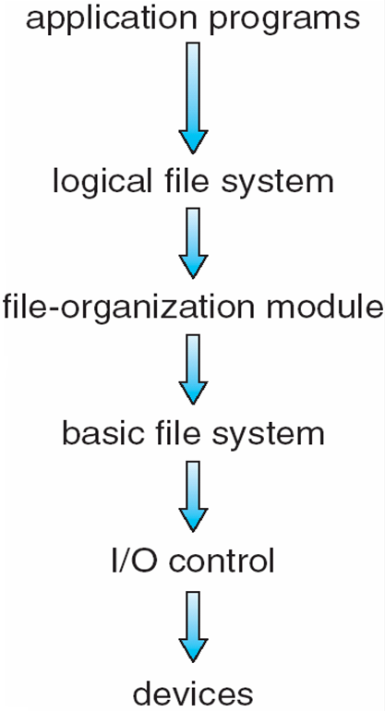
Layered File System
File control block – storage structure consisting of information about a file
Device driver controls the physical device File system organized into layers

Slide 40
File System Layers
Device drivers manage I/O devices at the I/O control layer
Given commands like “read drive1, cylinder 72, track 2, sector 10, into memory location 1060” outputs low-level hardware specific commands to hardware controller
Basic file system given command like “retrieve block 123” translates to device driver

Slide 41
File System Layers
Also manages memory buffers and caches (allocation, freeing, replacement)
Buffers hold data in transit
Caches hold frequently used data
File organization module understands files, logical address, and physical blocks
Translates logical block # to physical block #
Manages free space, disk allocation

Slide 42
File System Layers (Cont.)
Logical file system manages metadata information
Translates file name into file number, file handle, location by maintaining file control blocks (inodes in UNIX)
Directory management
Protection
Layering useful for reducing complexity and redundancy, but adds overhead and can decrease performanceTranslates file name into file number, file handle, location by maintaining file control blocks (inodes in UNIX)
Logical layers can be implemented by any coding method according to OS designer

Slide 43
File System Layers (Cont.)
Many file systems, sometimes many within an operating system
Each with its own format (CD-ROM is ISO 9660; Unix has UFS, FFS; Windows has FAT, FAT32, NTFS as well as floppy, CD, DVD Blu-ray, Linux has more than 40 types, with extended file system ext2 and ext3 leading; plus distributed file systems, etc.)
New ones still arriving – ZFS, GoogleFS, Oracle ASM, FUSE

Slide 44
File-System Implementation
We have system calls at the API level, but how do we implement their functions?
On-disk and in-memory structures
Boot control block contains info needed by system to boot OS from that volume
Needed if volume contains OS, usually first block of volume
Volume control block (superblock, master file table) contains volume details
Total # of blocks, # of free blocks, block size, free block pointers or array
Directory structure organizes the files
Names and inode numbers, master file table

Slide 45
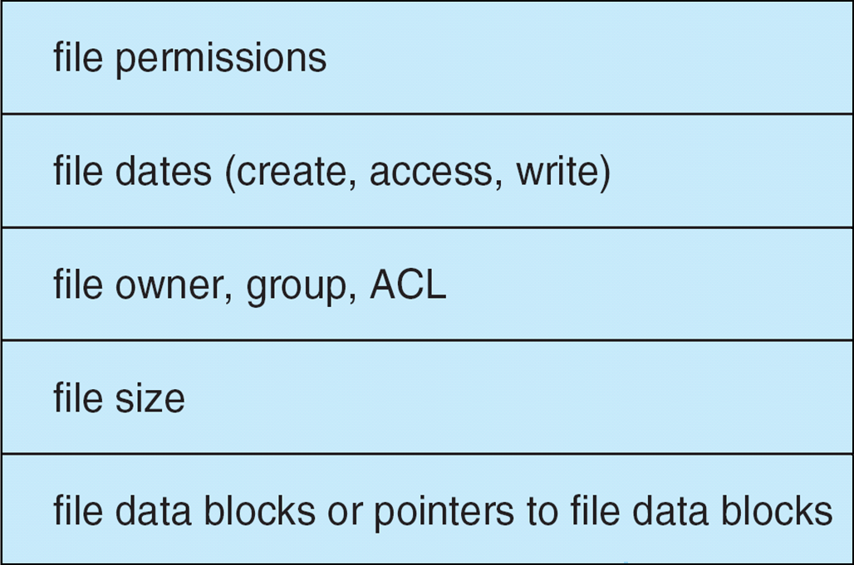
File-System Implementation (Cont.)
Per-file File Control Block (FCB) contains many details about the file
inode number, permissions, size, dates
NFTS stores into in master file table using relational DB structures

Slide 46
In-Memory File System Structures
Mount table storing file system mounts, mount points, file system types
The following figure illustrates the necessary file system structures provided by the operating systems
Plus buffers hold data blocks from secondary storage
Open returns a file handle for subsequent use
Data from read eventually copied to specified user process memory address

Slide 47
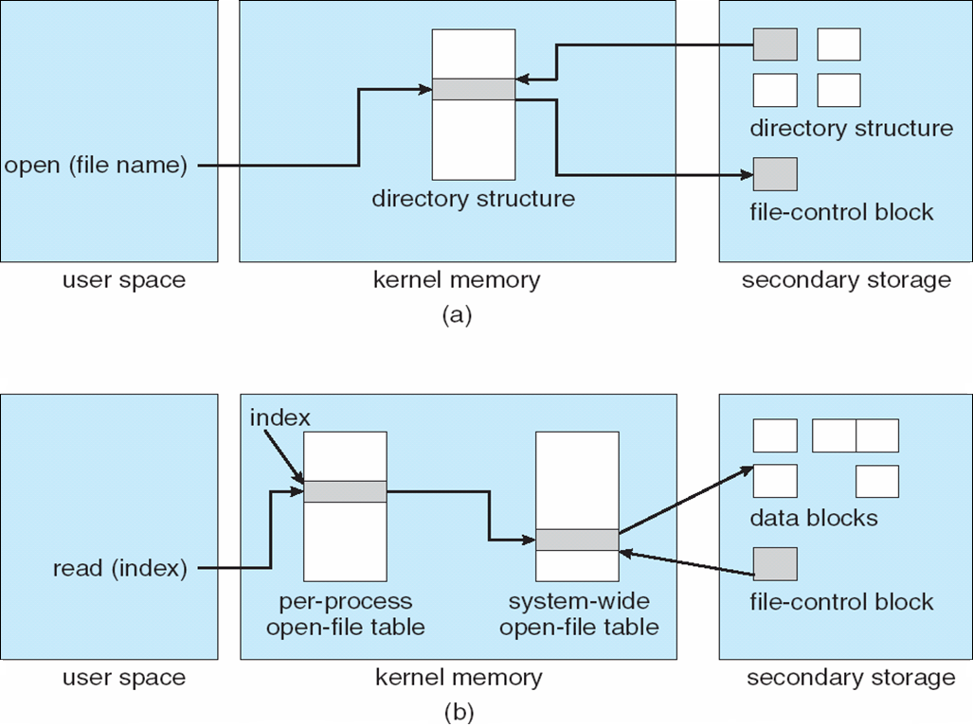
In-Memory File System Structures

Slide 48
Partitions and Mounting
Partition can be a volume containing a file system (“cooked”) or raw – just a sequence of blocks with no file system
Boot block can point to boot volume or boot loader set of blocks that contain enough code to know how to load the kernel from the file system
Or a boot management program for multi-os booting
Root partition contains the OS, other partitions can hold other Oses, other file systems, or be raw
Mounted at boot time
Other partitions can mount automatically or manually
At mount time, file system consistency checked
Is all metadata correct?
If not, fix it, try again
If yes, add to mount table, allow access

Slide 49
Virtual File Systems
Virtual File Systems (VFS) on Unix provide an object-oriented way of implementing file systems
VFS allows the same system call interface (the API) to be used for different types of file systems
Separates file-system generic operations from implementation details
Implementation can be one of many file systems types, or network file system
Implements vnodes which hold inodes or network file details
Then dispatches operation to appropriate file system implementation routines

Slide 50
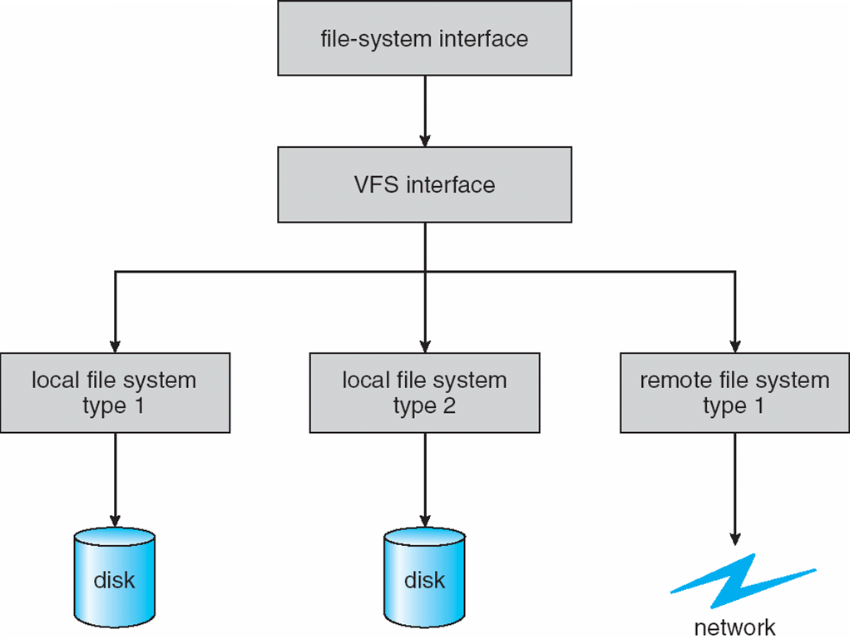
Virtual File Systems (Cont.)
The API is to the VFS interface, rather than any specific type of file system

Slide 51
Virtual File System Implementation
For example, Linux has four object types:
inode, file, superblock, dentry
VFS defines set of operations on the objects that must be implemented
Every object has a pointer to a function table
Function table has addresses of routines to implement that function on that object
For example:
• int open(. . .)—Open a file
• int close(. . .)—Close an already-open file
• ssize t read(. . .)—Read from a file
• ssize t write(. . .)—Write to a file
• int mmap(. . .)—Memory-map a file

Slide 52
Directory Implementation
Linear list of file names with pointer to the data blocks
Simple to program
Time-consuming to execute
Linear search time
Could keep ordered alphabetically via linked list or use B+ tree
Hash Table – linear list with hash data structure
Decreases directory search time
Collisions – situations where two file names hash to the same location
Only good if entries are fixed size, or use chained-overflow method

Slide 53
Allocation Methods - Contiguous
An allocation method refers to how disk blocks are allocated for files:
Contiguous allocation – each file occupies set of contiguous blocks
Best performance in most cases
Simple – only starting location (block #) and length (number of blocks) are required
Problems include finding space for file, knowing file size, external fragmentation, need for compaction off-line (downtime) or on-line

Slide 54
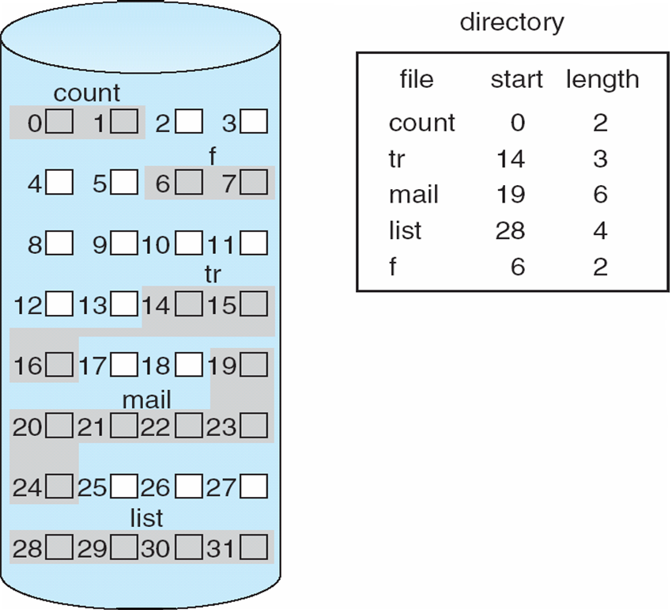
Contiguous Allocation
Mapping from logical to physical
Block to be accessed = Q + starting address
Displacement into block = R
Q
LA/512
R

Slide 55
Extent-Based Systems
Many newer file systems (i.e., Veritas File System) use a modified contiguous allocation scheme
Extent-based file systems allocate disk blocks in extents
An extent is a contiguous block of disks
Extents are allocated for file allocation
A file consists of one or more extents

Slide 56
Allocation Methods - Linked
Linked allocation – each file a linked list of blocks
File ends at nil pointer
No external fragmentation
Each block contains pointer to next block
No compaction, external fragmentation
Free space management system called when new block needed
Improve efficiency by clustering blocks into groups but increases internal fragmentation
Reliability can be a problem
Locating a block can take many I/Os and disk seeks

Slide 57
Allocation Methods – Linked (Contd.)
FAT (File Allocation Table) variation
Beginning of volume has table, indexed by block number
Much like a linked list, but faster on disk and cacheable
New block allocation simple

Slide 58
Linked Allocation
Each file is a linked list of disk blocks: blocks may be scattered anywhere on the disk
Mapping
Block to be accessed is the Qth block in the linked chain of blocks representing the file.
Displacement into block = R + 1
block =
pointer
Q
LA/511
R

Slide 59
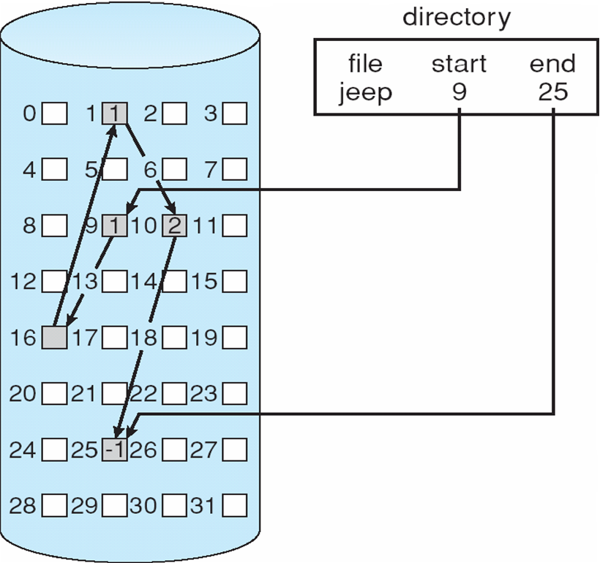
Linked Allocation

Slide 60
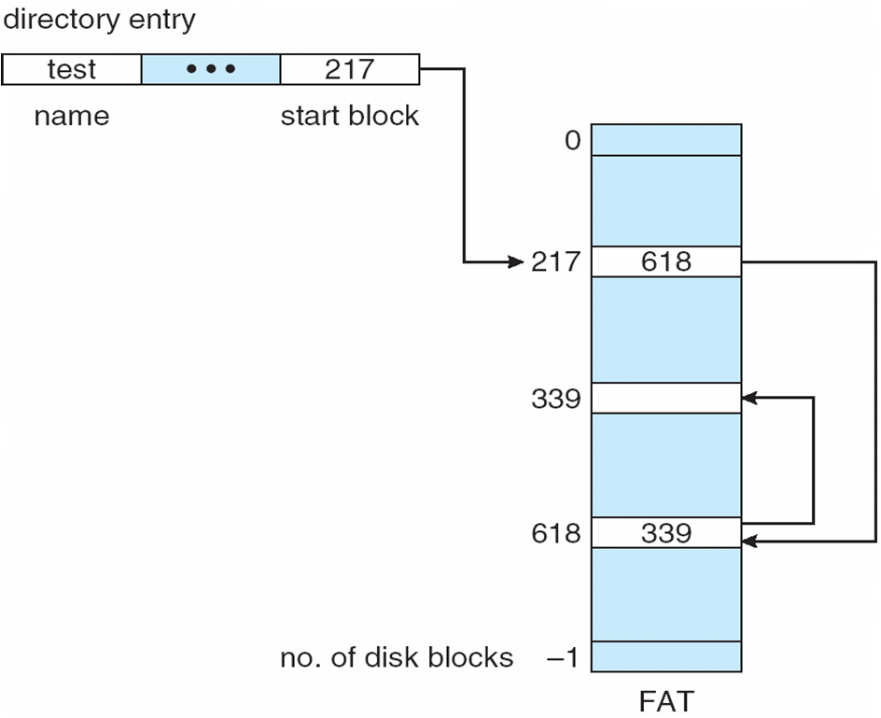
File-Allocation Table

Slide 61
Allocation Methods - Indexed
Indexed allocation
Each file has its own index block(s) of pointers to its data blocks
Logical view

Slide 62
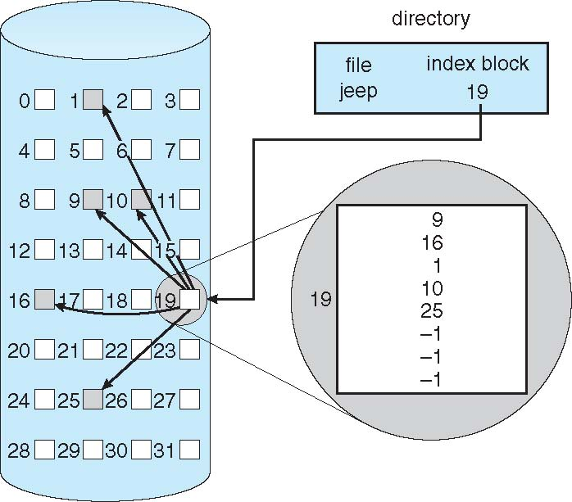
Example of Indexed Allocation

Slide 63
Indexed Allocation (Cont.)
Need index table
Random access
Dynamic access without external fragmentation, but have overhead of index block
Mapping from logical to physical in a file of maximum size of 256K bytes and block size of 512 bytes. We need only 1 block for index table
Q = displacement into index table
R = displacement into block
Q
LA/512
R

Slide 64
Indexed Allocation – Mapping (Cont.)
Mapping from logical to physical in a file of unbounded length (block size of 512 words)
Linked scheme – Link blocks of index table (no limit on size)
Q₁ = block of index table
R₁ is used as follows:
Q₂ = displacement into block of index table
R₂ displacement into block of file
LA / (512 x 511)
Q₁
R₁
Q₂
R₁ / 512
R₂

Slide 65
Indexed Allocation – Mapping (Cont.)
Two-level index (4K blocks could store 1,024 four-byte pointers in outer index -> 1,048,567 data blocks and file size of up to 4GB)
Q₁ = displacement into outer-index
R₁ is used as follows:
Q₂ = displacement into block of index table
R₂ displacement into block of file:
Q₁
LA / (512 x 512)
R₁
Q₂
R₁ / 512
R₂

Slide 66
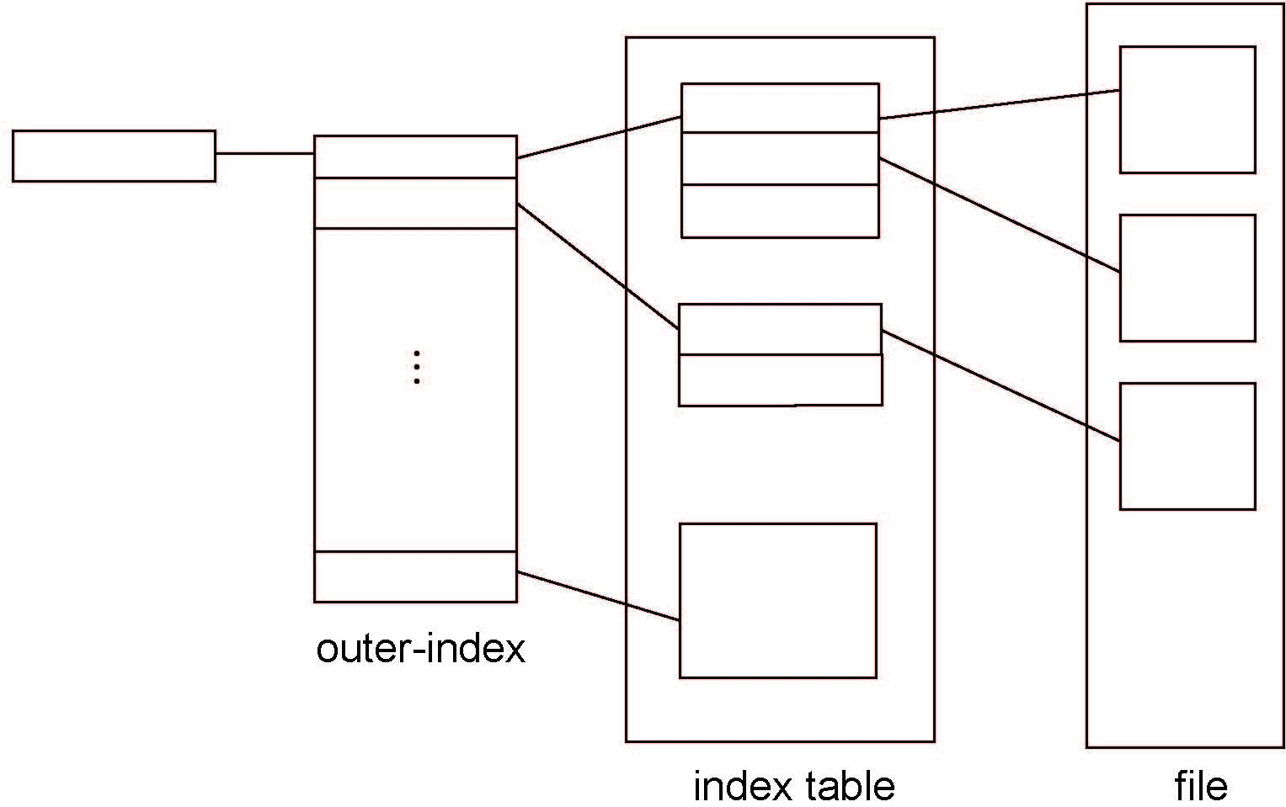
Indexed Allocation – Mapping (Cont.)

Slide 67
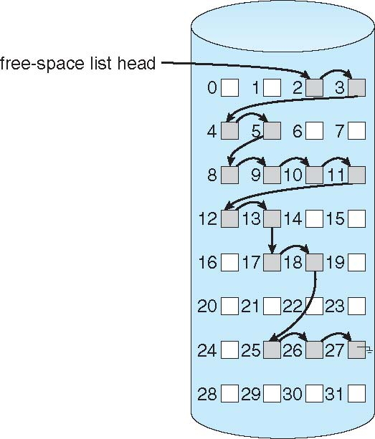
Linked Free Space List on Disk
Linked list (free list)
Cannot get contiguous space easily
No waste of space
No need to traverse the entire list (if # free blocks recorded)

Slide 68
Free-Space Management (Cont.)
Grouping
Modify linked list to store address of next n-1 free blocks in first free block, plus a pointer to next block that contains free-block-pointers (like this one)
Counting
Because space is frequently contiguously used and freed, with contiguous-allocation allocation, extents, or clustering
Keep address of first free block and count of following free blocks
Free space list then has entries containing addresses and counts

Slide 69
Free-Space Management (Cont.)
Space Maps
Used in ZFS
Consider meta-data I/O on very large file systems
Full data structures like bit maps couldn’t fit in memory -> thousands of I/Os
Divides device space into metaslab units and manages metaslabs
Given volume can contain hundreds of metaslabs
But records to log file rather than file system
Log of all block activity, in time order, in counting format
Metaslab activity -> load space map into memory in balanced-tree structure, indexed by offset
Replay log into that structure
Combine contiguous free blocks into single entry

Slide 70
End

